Slide 1
PYTHON PRACTICE PROGRAMS

Slide 2
1. Longest Substring Without Repeating Characters
Given a string, find the length of the longest substring without repeating characters.
Example 1:
Input: "abcabcbb"
Output: 3
Explanation: The answer is "abc", with the length of 3.
Example 2:
Input: "bbbbb"
Output: 1
Explanation: The answer is "b", with the length of 1.
Example 3:
Input: "pwwkew"
Output: 3
Explanation: The answer is "wke", with the length of 3.
Note that the answer must be a substring, "pwke" is a subsequence and not a substring.

Slide 3
Solution
s="abcabcbb“
ans = 0
sub = '‘
for char in s:
if char not in sub:
sub += char
ans = max(ans, len(sub))
else:
cut = sub.index(char)
sub = sub[cut+1:] + char
print(ans)

Slide 4
2. Group Anagrams
Given an array of strings, group anagrams together.
Example:
Input: ["eat", "tea", "tan", "ate", "nat", "bat"],
Output:
[
["ate","eat","tea"],
["nat","tan"],
["bat"]
]
Note:
All inputs will be in lowercase.
The order of your output does not matter.

Slide 5
Group Anagrams - Algorithm
We can transform each string s\text{s}s into a character count, count\text{count}count, consisting of 26 non-negative integers representing the number of a\text{a}a's, b\text{b}b's, c\text{c}c's, etc. We use these counts as the basis for our hash map.
In python, the representation will be a tuple of the counts. For example, abbccc will be (1, 2, 3, 0, 0, ..., 0), where again there are 26 entries total.

Slide 6
Solution :
class Solution:
def groupAnagrams(strs):
ans = collections.defaultdict(list)
for s in strs:
count = [0] * 26
for c in s:
count[ord(c) - ord('a')] += 1
ans[tuple(count)].append(s)
return ans.values()

Slide 7
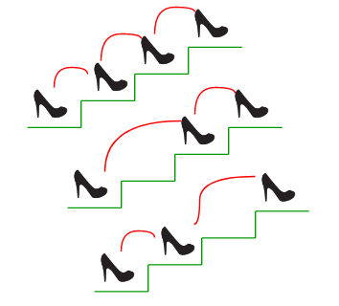
3. Count ways to reach nth stair
There are n stairs, a person standing at the bottom wants to reach the top. The person can climb either 1 stair or 2 stairs at a time. Count the number of ways, the person can reach the top.
Consider the example shown in diagram. The value of n is 3. There are 3 ways to reach the top. The diagram is taken from Easier Fibonacci puzzles.

Slide 8
Examples:
Input: n = 1
Output: 1
There is only one way to climb 1 stair.
Input: n = 2
Output: 2
There are two ways: (1, 1) and (2).
Input: n = 4
Output: 5
(1, 1, 1, 1), (1, 1, 2), (2, 1, 1), (1, 2, 1), (2, 2).

Slide 9
SOLUTION
We can easily find recursive nature in above problem. The person can reach n’th stair from either (n-1)’th stair or from (n-2)’th stair. Let the total number of ways to reach n’t stair be ‘ways(n)’. The value of ‘ways(n)’ can be written as following.
ways(n) = ways(n-1) + ways(n-2)
The above expression is actually the expression for Fibonacci numbers, but there is one thing to notice, the value of ways(n) is equal to fibonacci(n+1).
ways(1) = fib(2) = 1
ways(2) = fib(3) = 2
ways(3) = fib(4) = 3
So we can use function for fibonacci numbers to find the value of ways(n).

Slide 10
Solution
# Recurssive program to find n'th fibonacci number
def fib(n):
if n <= 1:
return n
return fib(n-1) + fib(n-2)
# returns no. of ways to reach s'th stair
def countWays(s):
return fib(s + 1)
# Driver program
s = 4
print ("Number of ways = ", countWays(s) )

Slide 11
4. Maximum subarray sum modulo m
Given an array of n elements and an integer m. The task is to find the maximum value of the sum of its subarray modulo m i.e find the sum of each subarray mod m and print the maximum value of this modulo operation.
Examples:
Input : arr[] = { 3, 3, 9, 9, 5 }
m = 7
Output : 6

Slide 12
All sub-arrays and their value:
{ 9 } => 9%7 = 2
{ 3 } => 3%7 = 3
{ 5 } => 5%7 = 5
{ 9, 5 } => 14%7 = 2
{ 9, 9 } => 18%7 = 4
{ 3, 9 } => 12%7 = 5
{ 3, 3 } => 6%7 = 6
{ 3, 9, 9 } => 21%7 = 0
{ 3, 3, 9 } => 15%7 = 1
{ 9, 9, 5 } => 23%7 = 2
{ 3, 3, 9, 9 } => 24%7 = 3
{ 3, 9, 9, 5 } => 26%7 = 5
{ 3, 3, 9, 9, 5 } => 29%7 = 1

Slide 13
Input : arr[] = {10, 7, 18}
m = 13
Output : 12
The subarray {7, 18} has maximum sub-array
sum modulo 13.

Slide 14
5. Find a triplet a, b, c such that a² = b² + c²
Variations of this problem –
1) Find a triplet with sum equal to 0.
2) Find a pair with given sum.
Input:
The first line contains T, denoting the number of testcases. Then follows description of testcases. Each case begins with a single positive integer N denoting the size of array. The second line contains the N space separated positive integers denoting the elements of array A.

Slide 15
PROGRAMMING QUESTIONS
Output:
For each testcase, print "Yes" or "No" whether it is Pythagorean Triplet or not (without quotes).
Constraints:
1 <= T <= 100
1 <= N <= 107
1 <= A[i] <= 1000
Example:
Input:
1
5
3 2 4 6 5

Slide 16
PROGRAMMING QUESTIONS
Output:
Yes
Explanation:
Testcase 1:
3, 4, and 5 forms a pythagorean triplet, so we print "Yes"

Slide 17
SOLUTION
Method 1 (Naive) A simple solution is to run three loops, three loops pick three array elements and check if current three elements form a Pythagorean Triplet.
Time Complexity of the above solution is O(n³).

Slide 18
SOLUTION
Method 2 (Use Sorting) We can solve this in O(n²) time by sorting the array first.
1) Do square of every element in input array. This step takes O(n) time.
2) Sort the squared array in increasing order. This step takes O(nLogn) time.
3) To find a triplet (a, b, c) such that a² = b² + c², do following.
3.1) Fix ‘a’ as last element of sorted array.
3.2) Now search for pair (b, c) in subarray between first element and ‘a’. A pair (b, c) with given sum can be found in O(n) time
3.3)If no pair found for current ‘a’, then move ‘a’ one position back and repeat step 3.2.
Time complexity of this method is O(n²).

Slide 19
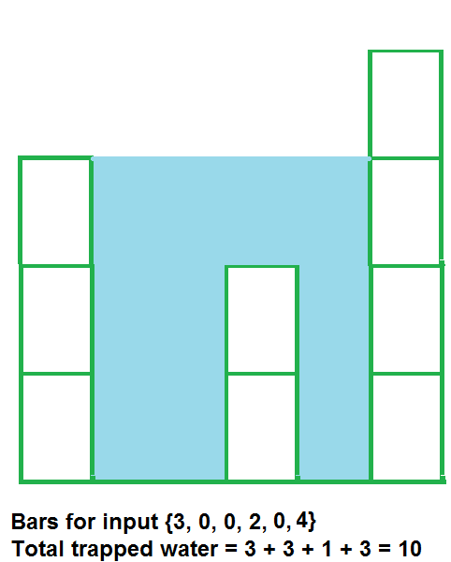
6. Trapping Rain Water
Given n non-negative integers representing an elevation map where the width of each bar is 1, compute how much water it is able to trap after raining.

Slide 20
Trapping Rain Water Sample Input
Examples:
Input: arr[] = {2, 0, 2}
Output: 2
Structure is like below
| |
|_|
We can trap 2 units of water in the middle gap.
Input: arr[] = {3, 0, 0, 2, 0, 4}
Output: 10
Structure is like below
|
| |
| | |
|__|_|
We can trap "3*2 units" of water between 3 an 2,
"1 unit" on top of bar 2 and "3 units" between 2
and 4. See below diagram also.
Input: arr[] = [0, 1, 0, 2, 1, 0, 1, 3, 2, 1, 2, 1]
Output: 6
|
| || |
_|_||_||||||
Trap "1 unit" between first 1 and 2, "4 units" between
first 2 and 3 and "1 unit" between second last 1 and last 2

Slide 21
7. Matrix Rotation
Given an square matrix, turn it by 90 degrees in anti-clockwise direction without using any extra space.

Slide 22
Example
Input 1 2 3 4 5 6 7 8 9 Output: 3 6 9 2 5 8 1 4 7
Input: 1 2 3 4 5 6 7 8 9 10 11 12 13 14 15 16 Output: 4 8 12 16 3 7 11 15 2 6 10 14 1 5 9 13

Slide 23
How to do without extra space?
Below are some important observations.
First row of source –> First column of destination, elements filled in opposite order
Second row of source –> Second column of destination, elements filled in opposite order
so … on
Last row of source –> Last column of destination, elements filled in opposite order.
An N x N matrix will have floor(N/2) square cycles. For example, a 4 X 4 matrix will have 2 cycles. The first cycle is formed by its 1st row, last column, last row and 1st column. The second cycle is formed by 2nd row, second-last column, second-last row and 2nd column
The idea is for each square cycle, we swap the elements involved with the corresponding cell in the matrix in anti-clockwise direction i.e. from top to left, left to bottom, bottom to right and from right to top one at a time.
We use nothing but a temporary variable to achieve this.

Slide 24
Demonstration of the Idea
First Cycle (Involves Red Elements) 1 2 3 4 5 6 7 8 9 10 11 12 13 14 15 16 Moving first group of four elements (First elements of 1st row, last row, 1st column and last column) of first cycle in counter clockwise. 4 2 3 16 5 6 7 8 9 10 11 12 1 14 15 13 Moving next group of four elements of first cycle in counter clockwise 4 8 3 16 5 6 7 15 2 10 11 12 1 14 9 13 Moving final group of four elements of first cycle in counter clockwise 4 8 12 16 3 6 7 15 2 10 11 14 1 5 9 13 Second Cycle (Involves Blue Elements) 4 8 12 16 3 6 7 15 2 10 11 14 1 5 9 13 Fixing second cycle 4 8 12 16 3 7 11 15 2 6 10 14 1 5 9 13

Slide 25
SOLUTION
METHOD 2
Rotate a matrix by 90 degree without using any extra space
Given a square matrix, turn it by 90 degrees in anti-clockwise direction without using any extra space.
There are two steps :
Find transpose of matrix.
Reverse columns of the transpose.

Slide 26
8. Sliding Window Maximum (Maximum of all subarrays of size k)
Given an array and an integer k, find the maximum for each and every contiguous subarray of size k.
Examples :
Input : arr[] = {1, 2, 3, 1, 4, 5, 2, 3, 6} k = 3 Output : 3 3 4 5 5 5 6 Input : arr[] = {8, 5, 10, 7, 9, 4, 15, 12, 90, 13} k = 4 Output : 10 10 10 15 15 90 90

Slide 27
SOLUTION
Method 1 (Simple) Run two loops. In the outer loop, take all subarrays of size k. In the inner loop, get the maximum of the current subarray.
Time Complexity : The outer loop runs n-k+1 times and the inner loop runs k times for every iteration of outer loop. So time complexity is O((n-k+1)*k) which can also be written as O(nk).

